Slide 1


INTERNATIONAL CONFERENCE ON ADVANCED DATA-DRIVEN INTELLIGENCE AND ENGINEERING ICADIE 2024 [7th-8th March] Sleep Monitoring System Using Machine Learning
Sachin Singh
Manish Yadav
Priyanka Kumari
Aayushma Thapa
Samyak Maharjan
Preeti Kurmi
Under the guidance of Mr. Santhosh S

Slide 2
Contents
Abstract
Introduction
Problem Definition
Literature Survey
Proposed Architecture
Results & Discussion
Conclusion
References

Slide 3
ABSTRACT
Sleep is a crucial component of overall human health, and many people struggle to get enough high-quality sleep. To help individuals improve their sleep quality, we propose a sleep monitoring system that uses a smartwatch and machine learning algorithms. This system gathers data on different elements related to sleep such as duration, quality, and physiological factors, which are analyzed using Naive Bayes machine learning algorithms to provide personalized insights and recommendations for improving sleep. These recommendations could include adjustments to sleep schedules, changes to sleep hygiene practices, or dietary changes that can improve sleep. By providing personalized recommendations tailored to each individual's unique sleep patterns and physiological factors, this system has the potential to be a powerful tool for improving sleep quality and overall health. With the increasing popularity of wearable technology and the growing demand for personalized health solutions, a sleep monitoring system that uses a smartwatch and machine learning algorithms could be a valuable tool for improving sleep quality and overall well-being

Slide 4
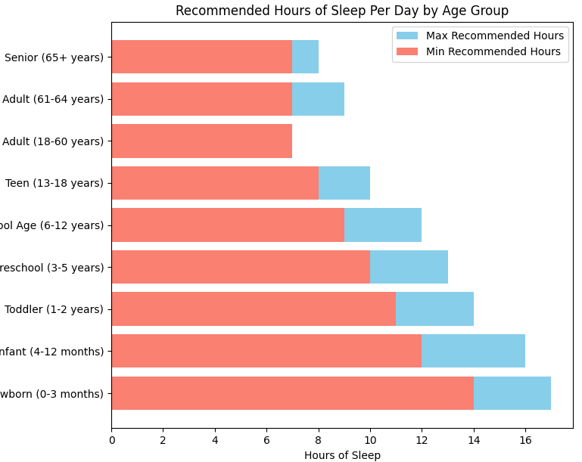
INTRODUCTION
Sleeping is the need of the human body for their survivals and allows the user to remain fresh.
There are many benefits which user gets while having the sufficient sleep which includes sleep keep heart healthy, prevent cancer, reduces stress, reduces inflammation, makes you more alert, improves your memory, help you lose weight, makes you smarter.
In the past, some methods using Electroencephalograms (EEG) or Electromyograms (EMG) have been proposed for sleep disorder monitoring. However, these methods are very inconvenient for the patients due to the cumbersome wiring that is required for the bio signal acquisition.
The system which we implement will senses the activities whether we are sleeping in a right posture or not it detects our daily sleeping routines. It will monitor the sleeping activity of a person and will provide feedback that will help person in improving quality of sleep.

Slide 5
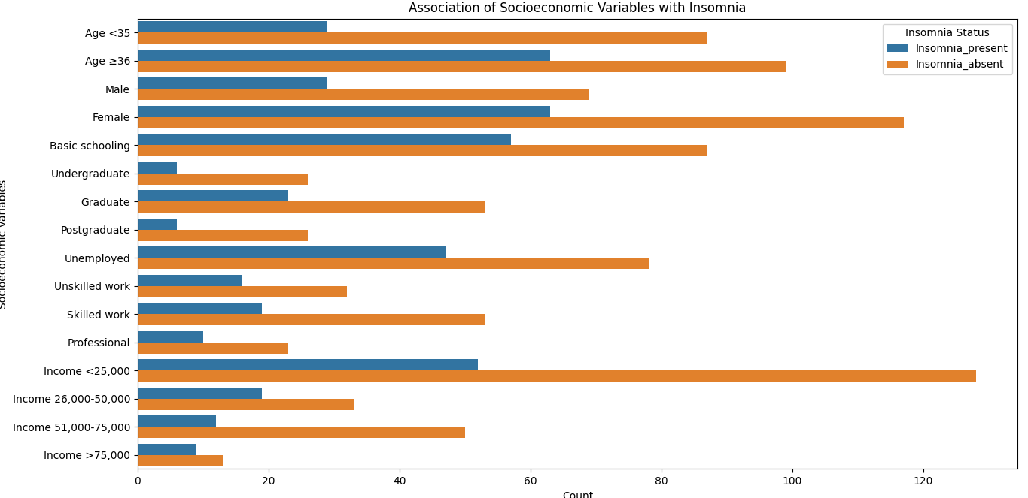
PROBLEM DEFINITION
In addressing the significant health issue of inadequate sleep, which affects a considerable portion of the population and can lead to serious physical and mental health problems such as obesity, diabetes, hypertension, depression, and anxiety, it is crucial to acknowledge the varying impact on different socioeconomic groups. Insomnia prevalently affects people from diverse socioeconomic backgrounds in distinct ways. For instance, individuals with basic schooling or those unemployed show higher instances of insomnia compared to other groups. Such disparities highlight the need for a tailored approach to sleep improvement.

Slide 6
LITERATURE SURVEY
S.N. | Title | Summery
1. | Sleep Monitoring Systems: Current Status and Future Challenges | The article highlights the accuracy and practicality issues with current sleep monitoring methods and calls for the development of new monitoring technologies, standardization of measurement techniques, increased collaboration, and more research into the relationship between sleep and health.
2. | A Real-Time Sleep Monitoring System with a Smartphone | The study describes a real-time sleep monitoring system using a smartphone's sensors and machine learning algorithms to track sleep patterns and stages, addressing the shortcomings of existing technology.

Slide 7
LITERATURE SURVEY
S.N. | Title | Summery
3. | Internet of Things for Sleep Quality Monitoring System: A Survey | The study reviews the use of the Internet of Things (IoT) for sleep quality monitoring, discussing sensor technology, data analytics, privacy and security concerns, and proposes combining sensors with data analytics techniques to improve precision.
4. | Development of a sleep monitoring system with wearable vital sensor for home use | The study aims to develop a wearable home sleep monitoring system to enhance sleep quality and identify sleep disorders, utilizing a wearable sensor to measure vital signs and evaluating challenges in creating such a system.

Slide 8
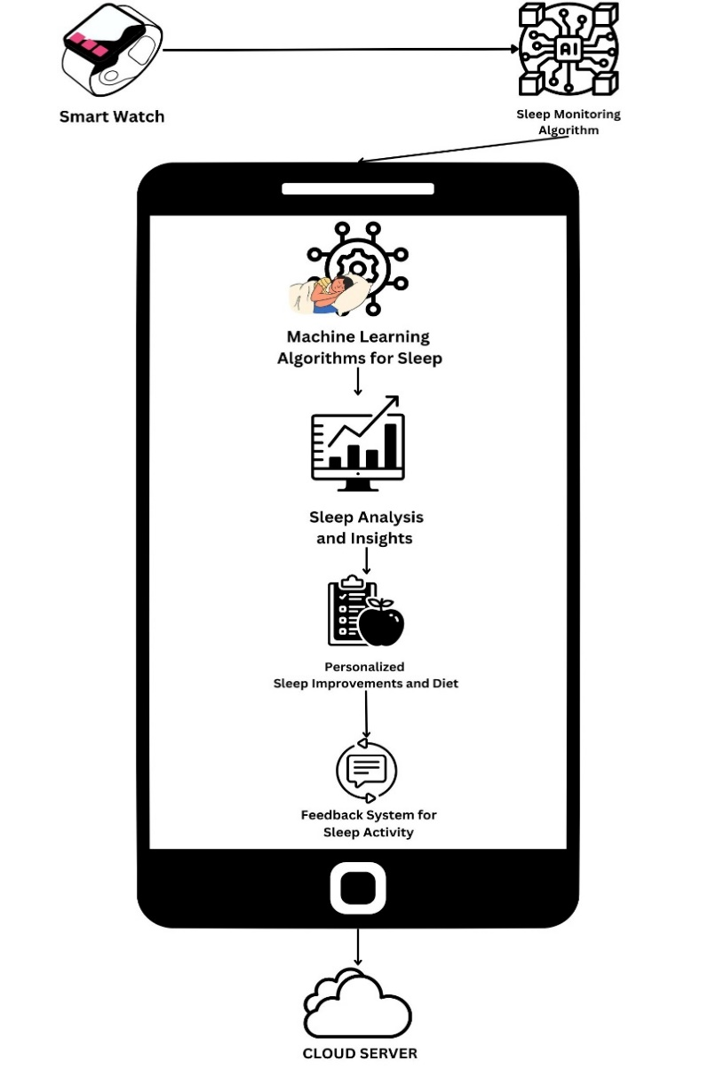
PROPOSED ARCHITECURE
The components in the System are :
Smartwatch
Sleep Monitoring Algorithm
Machine Learning Algorithms
Sleep Analysis and Insights
Personalized Sleep Improvements and Diet
Feedback System for Sleep Activity
Sleep Data Storage

Slide 9
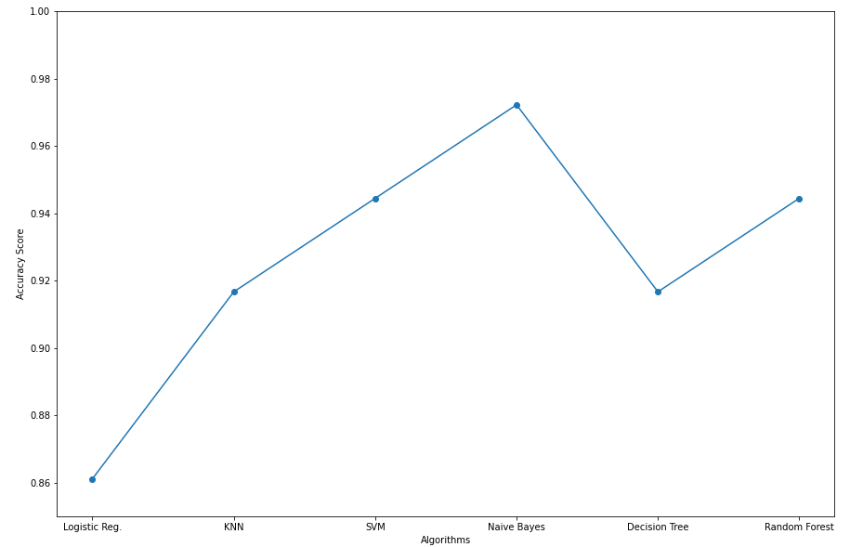
RESULTS & DISCUSSION
This section presents a comparative analysis of several machine learning algorithms, including Logistic Regression, SVM, KNN, Random Forest, Naive Bayes, and Decision Tree
In an extensive comparison of available sleep monitoring algorithms, the Naive Bayes algorithm emerged as the most accurate.
The accuracy of Naive Bayes in our tests underscores its potential as a reliable tool in sleep quality assessment, aligning with the system's goal to deliver precise and personalized sleep health insights.

Slide 10
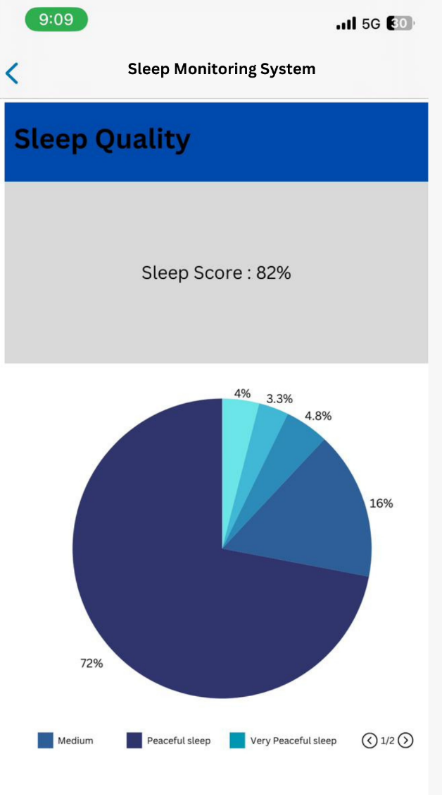
CONCLUSION
In conclusion, a sleep monitoring system uses a smartwatch and machine learning algorithms provides recommendations for improving their sleep quality.
By collecting data on sleep duration, sleep quality, and other sleep-related metrics, the system can provide personalized insights into sleep patterns, such as when the user is most likely to wake up and how often they wake up during the night.
The system can provide users with a comprehensive set of recommendations for improving their overall health and well-being.
A sleep monitoring system that uses a smartwatch and machine learning algorithms has the potential to be a powerful tool for individuals looking to improve their sleep quality and overall health.
This system can provide users with valuable insights and personalized recommendations, ultimately leading to better sleep and a better quality of life.

Slide 11
REFERENCES
“How Much Sleep Do I Need? | CDC.” Accessed: Feb. 08, 2024. [Online]. Available: https://www.cdc.gov/sleep/about_sleep/how_much_sleep.html
. Bhaskar, D. Hemavathy, and S. Prasad, “Prevalence of chronic insomnia in adult patients and its correlation with medical comorbidities,” J Family Med Prim Care, vol. 5, no. 4, p. 780, 2016, doi: 10.4103/2249-4863.201153
Q. Pan, D. Brulin, and E. Campo, “Current Status and Future Challenges of Sleep Monitoring Systems: Systematic Review,” JMIR Biomed Eng, vol. 5, no. 1, p. e20921, Aug. 2020, doi: 10.2196/20921.
T. Y. Han, S. D. Min, and Y. Nam, “A Real-Time Sleep Monitoring System with a Smartphone,” in Proceedings - 2015 9th International Conference on Innovative Mobile and Internet Services in Ubiquitous Computing, IMIS 2015, Institute of Electrical and Electronics Engineers Inc., Sep. 2015, pp. 458–461. doi: 10.1109/IMIS.2015.69.
Universitas Bina Nusantara, Institute of Electrical and Electronics Engineers, and Institute of Electrical and Electronics Engineers. Indonesia Section, Proceedings, the Eleventh 2016 International Conference on Knowledge, Information and Creativity Support Systems (The KICSS 2016) : 10-11 November 2016, Royal Ambarrukmo Yogyakarta Hotel, Yogyakarta, Indonesia.
K. Ouchi, T. Suzuki, K.-I. Kameyama, and M. Takahashi, “Development of a Sleep Monitoring System with Wearable Vital Sensor for Home Use. DEVELOPMENT OF A SLEEP MONITORING SYSTEM WITH WEARABLE VITAL SENSOR FOR HOME USE,” 2009. [Online]. Available: https://www.researchgate.net/publication/221335140
J. H. Shin, Y. J. Chee, D. U. Jeong, and K. S. Park, “Nonconstrained sleep monitoring system and algorithms using air-mattress with balancing tube method,” in IEEE Transactions on Information Technology in Biomedicine, Jan. 2010, pp. 147–156. doi: 10.1109/TITB.2009.2034011.
D. C. Mack, J. T. Patrie, P. M. Suratt, R. A. Felder, and M. Alwan, “Development and preliminary validation of heart rate and breathing rate detection using a passive, ballistocardiography-based sleep monitoring system,” IEEE Transactions on Information Technology in Biomedicine, vol. 13, no. 1, pp. 111–120, 2009, doi: 10.1109/TITB.2008.2007194.
J. Shin, Y. Chee, and K. Park, “Long-term Sleep Monitoring System and Long-term Sleep Parameters using Unconstrained Method,” IEEE, 2018.
M. De Zambotti, F. C. Baker, and I. M. Colrain, “Validation of sleep-tracking technology compared with polysomnography in adolescents,” Sleep, vol. 38, no. 9, pp. 1461–1468, Sep. 2015, doi: 10.5665/sleep.4990.

Slide 12
REFERENCES
Z. Liang and B. Ploderer, “Sleep tracking in the real world: A qualitative study into barriers for improving sleep,” in Proceedings of the 28th Australian Computer-Human Interaction Conference, OzCHI 2016, Association for Computing Machinery, Inc, Nov. 2016, pp. 537–541. doi: 10.1145/3010915.3010988.
M. W. Driller et al., “Pyjamas, Polysomnography and Professional Athletes: The Role of Sleep Tracking Technology in Sport,” Sports, vol. 11, no. 1. MDPI, Jan. 01, 2023. doi: 10.3390/sports11010014.
E. Kuosmanen, “How Does Sleep Tracking Influence Your Life? Experiences from a Longitudinal Field Study with a Wearable Ring.” [Online]. Available: https://www.withings.com/mx/en/sleep
G. Chen, Institute of Electrical and Electronics Engineers. Beijing Section. Reliability Society Chapter, and Institute of Electrical and Electronics Engineers, 2019 2nd International Conference on Safety Produce Informatization (IICSPI) : proceedings : Chongqing, China, November 28-30, 2019.
2020 IEEE 91st Vehicular Technology Conference (VTC Spring) : proceedings : Antwerp, Belgium, 25-28 May 2020.
IEEE Poland Section and Institute of Electrical and Electronics Engineers, 7th IEEE International Conference on Cognitive Infocommunications : CogInfoCom 2016 : proceedings : October 16-18, 2016, Wrocław. Poland.
V. Ibáñez, J. Silva, and O. Cauli, “A survey on sleep assessment methods,” PeerJ, vol. 2018, no. 5, 2018, doi: 10.7717/peerj.4849.
A. Biajar, T. Mollayeva, S. Sokoloff, and A. Colantonio, “Assistive technology to enable sleep function in patients with acquired brain injury: Issues and opportunities,” British Journal of Occupational Therapy, vol. 80, no. 4. SAGE Publications Inc., pp. 225–249, Apr. 01, 2017. doi: 10.1177/0308022616688017.
V. Metsis, D. Kosmopoulos, V. Athitsos, and F. Makedon, “Non-invasive analysis of sleep patterns via multimodal sensor input,” in Personal and Ubiquitous Computing, Springer London, Jan. 2014, pp. 19–26. doi: 10.1007/s00779-012-0623-1.
X. K. Lee et al., “Validation of a consumer sleep wearable device with actigraphy and polysomnography in adolescents across sleep opportunity manipulations,” Journal of Clinical Sleep Medicine, vol. 15, no. 9, pp. 1337–1346, Sep. 2019, doi: 10.5664/jcsm.7932.
E. Tobaldini, L. Nobili, S. Strada, K. R. Casali, A. Braghiroli, and N. Montano, “Heart rate variability in normal and pathological sleep,” Front Physiol, vol. 4, pp. 1–11, Oct. 2013, doi: 10.3389/fphys.2013.00294.
12

Slide 13
Thank You

